Slide 1
Flip-Flops
Reference
Moris Mano 4th Edition
Chapter 5

Slide 2
Synchronization in Digital Systems
Clock Generator
Clock Pulses
Hertz (Cycles per second)

Slide 3
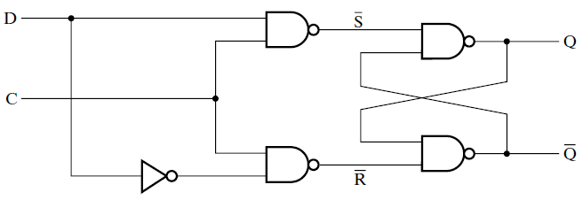
D Latch
Latch
Triggers
When C = 1
(i.e. changes its state according to input signal)
C | D | Next State of Q
0 | X | No Change
1 | 0 | Q=0, Reset State
1 | 1 | Q = 1, Set State
C = Control Input
D = Data Input
Function Table

Slide 4
D Latch
Clock
Pulse
= C
C | D | Next State of Q
0 | X | No Change
1 | 0 | Q=0, Reset State
1 | 1 | Q = 1, Set State
Clock pulse as
Control Input
D = Data Input
Function Table

Slide 5
Transparency Issue with Latches

Slide 6
Flip-Flops

Slide 7
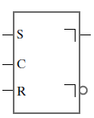
SR Master-Slave Flip-Flop
Q
Q’
Right angle means
Update State of
Flip-flop when
Clock Pulse = 0
Graphic Symbol

Slide 8
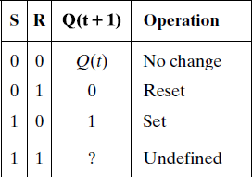
SR Master-Slave Flip-Flop
Characteristic Table

Slide 9
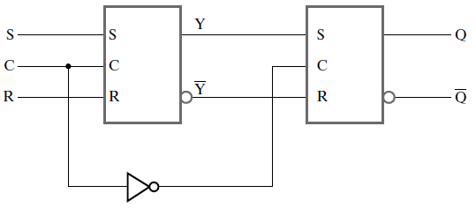
SR Master-Slave Flip-Flop
Master
Latch
Slave
Latch
Clock Pulse

Slide 10
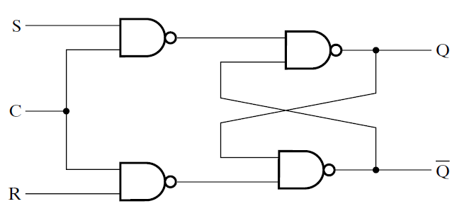
SR Latch with Control Input
Input
C | S | R | Next State Of Q
0 | X | X | No Change
1 | 0 | 0 | No Change
1 | 0 | 1 | Q=0, Reset
1 | 1 | 0 | Q=1, Set
1 | 1 | 1 | Undefined
Logic Diagram
Function Table

Slide 11
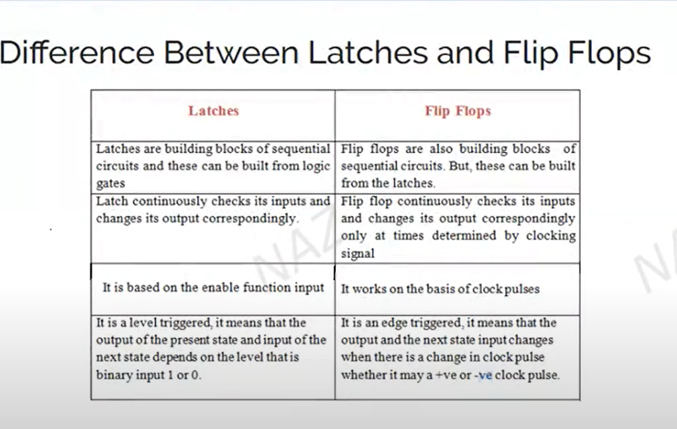

Slide 12
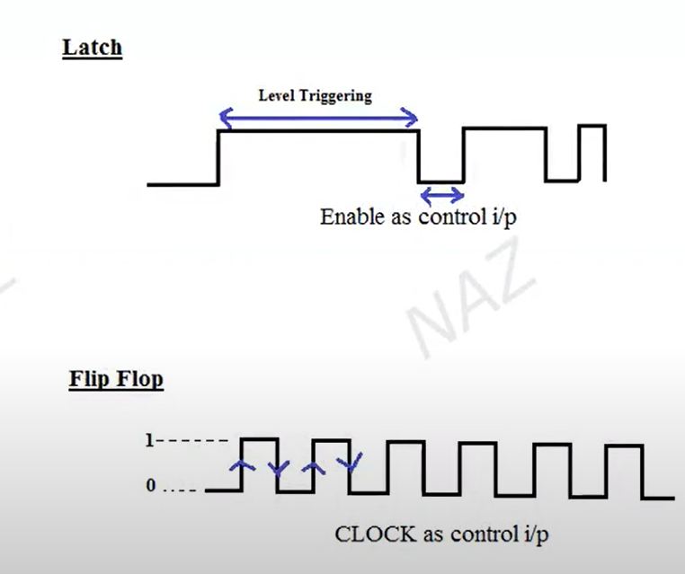

Slide 13
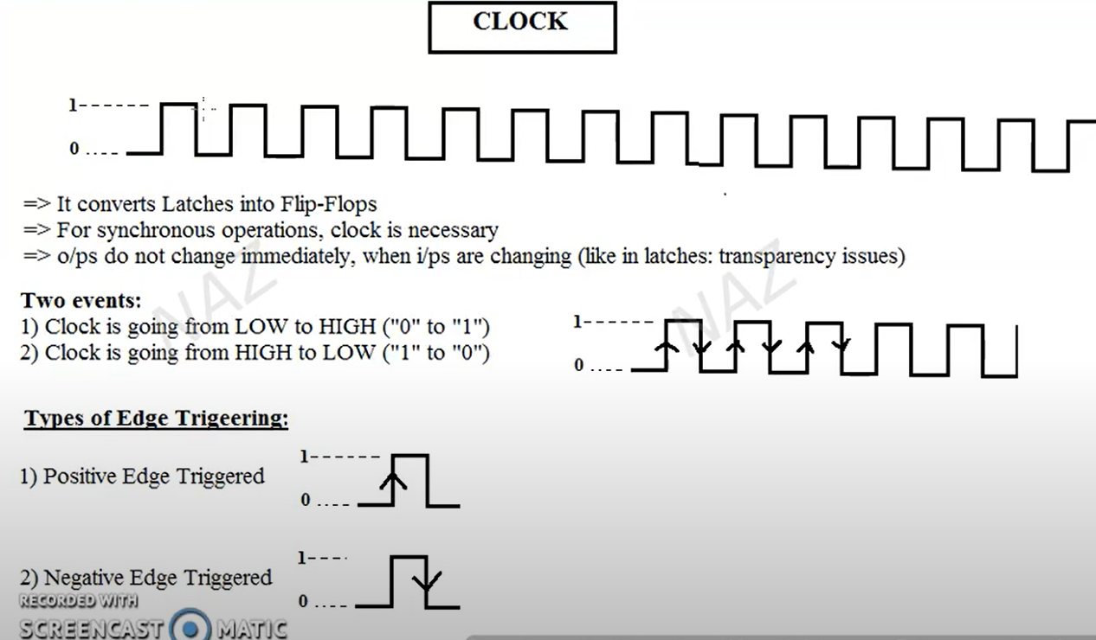

Slide 14
SR Master-Slave Flip-Flop Clock input C = 1
Master
Slave
1
0
Enabled
Disabled

Slide 15
SR Master-Slave Flip-Flop Clock input C = 0
Master
Slave
0
1
Disabled
Enabled

Slide 16
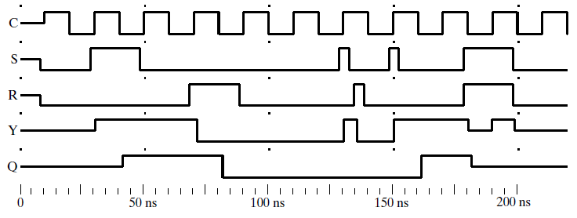
How SR Master-Slave Flip-Flop works?
Clock
Output of
Flip Flop
Logic Simulation of SR Master-Slave Flip-Flop

Slide 17
How SR Master-Slave Flip-Flop works?

Slide 18
How SR Master-Slave Flip-Flop works?

Slide 19
How SR Master-Slave Flip-Flop works?
Value
Of all
The Signals
Are unknown

Slide 20
How SR Master-Slave Flip-Flop works?
Input
C | S | R | Next State Of Q
0 | X | X | No Change
1 | 0 | 0 | No Change
1 | 0 | 1 | Q=0, Reset
1 | 1 | 0 | Q=1, Set
1 | 1 | 1 | Undefined
0
1
0
0
FT of SR Latch

Slide 21
How SR Master-Slave Flip-Flop works?
Input
C | S | R | Next State Of Q
0 | X | X | No Change
1 | 0 | 0 | No Change
1 | 0 | 1 | Q=0, Reset
1 | 1 | 0 | Q=1, Set
1 | 1 | 1 | Undefined
0
1
0
0
FT of SR Latch
Saving
Previous
Values

Slide 22
How SR Master-Slave Flip-Flop works?
Input
C | S | R | Next State Of Q
0 | X | X | No Change
1 | 0 | 0 | No Change
1 | 0 | 1 | Q=0, Reset
1 | 1 | 0 | Q=1, Set
1 | 1 | 1 | Undefined
Y
0
1
Y’
FT of SR Latch
Saving
Previous
Values

Slide 23
How SR Master-Slave Flip-Flop works?
Characteristic Table
Of SR Master-Slave FF
(S,R)
= (0,0)
Flip-Flop
Saving
Previous
Values

Slide 24
How SR Master-Slave Flip-Flop works?
Input
C | S | R | Next State Of Q
0 | X | X | No Change
1 | 0 | 0 | No Change
1 | 0 | 1 | Q=0, Reset
1 | 1 | 0 | Q=1, Set
1 | 1 | 1 | Undefined
1
1
0
0
FT of SR Latch

Slide 25
How SR Master-Slave Flip-Flop works?
Input
C | S | R | Next State Of Q
0 | X | X | No Change
1 | 0 | 0 | No Change
1 | 0 | 1 | Q=0, Reset
1 | 1 | 0 | Q=1, Set
1 | 1 | 1 | Undefined
1
1
1
0
0
0
FT of SR Latch

Slide 26
How SR Master-Slave Flip-Flop works?
Input
C | S | R | Next State Of Q
0 | X | X | No Change
1 | 0 | 0 | No Change
1 | 0 | 1 | Q=0, Reset
1 | 1 | 0 | Q=1, Set
1 | 1 | 1 | Undefined
1
1
1
0
1
0
0
0
FT of SR Latch

Slide 27
How SR Master-Slave Flip-Flop works?
1
1
1
0
1
0
0
0
Characteristic Table
Of SR Master-Slave FF
(S,R)
= (1,0)
Flip-Flop
Set

Slide 28
How SR Master-Slave Flip-Flop works?
0
1
1
0
1
0
0
0
Characteristic Table
Of SR Master-Slave FF
(S,R)
= (0,0)
Flip-Flop
Retaining
State
(No Change)
1 Clock Cycle

Slide 29
How SR Master-Slave Flip-Flop works?
Input
C | S | R | Next State Of Q
0 | X | X | No Change
1 | 0 | 0 | No Change
1 | 0 | 1 | Q=0, Reset
1 | 1 | 0 | Q=1, Set
1 | 1 | 1 | Undefined
0
0
1
1
0
1
1
0
FT of SR Latch

Slide 30
How SR Master-Slave Flip-Flop works?
Input
C | S | R | Next State Of Q
0 | X | X | No Change
1 | 0 | 0 | No Change
1 | 0 | 1 | Q=0, Reset
1 | 1 | 0 | Q=1, Set
1 | 1 | 1 | Undefined
0
0
0
0
1
1
1
1
FT of SR Latch

Slide 31
How SR Master-Slave Flip-Flop works?
0
0
0
0
1
1
1
1
Characteristic Table
Of SR Master-Slave FF
(S,R)
= (0,1)
Flip-Flop
ReSet
(Q=0)

Slide 32
How SR Master-Slave Flip-Flop works?
0
0
0
0
1
0
1
1
Characteristic Table
Of SR Master-Slave FF
(S,R)
= (0,0)
Flip-Flop
Retaining
State
(No Change)

Slide 33
How SR Master-Slave Flip-Flop works?
0
0
0
0
1
0
1
1
Characteristic Table
Of SR Master-Slave FF
(S,R)
= (0,0)
Flip-Flop
Retaining
State
(No Change)

Slide 34
How SR Master-Slave Flip-Flop works?
Input
C | S | R | Next State Of Q
0 | X | X | No Change
1 | 0 | 0 | No Change
1 | 0 | 1 | Q=0, Reset
1 | 1 | 0 | Q=1, Set
1 | 1 | 1 | Undefined
1
1
0
1
0
0
0
1
FT of SR Latch

Slide 35
How SR Master-Slave Flip-Flop works?
Input
C | S | R | Next State Of Q
0 | X | X | No Change
1 | 0 | 0 | No Change
1 | 0 | 1 | Q=0, Reset
1 | 1 | 0 | Q=1, Set
1 | 1 | 1 | Undefined
0
0
0
1
0
1
1
1
FT of SR Latch

Slide 36
How SR Master-Slave Flip-Flop works?
Input
C | S | R | Next State Of Q
0 | X | X | No Change
1 | 0 | 0 | No Change
1 | 0 | 1 | Q=0, Reset
1 | 1 | 0 | Q=1, Set
1 | 1 | 1 | Undefined
0
0
0
1
0
0
1
1
FT of SR Latch

Slide 37
How SR Master-Slave Flip-Flop works?
Input
C | S | R | Next State Of Q
0 | X | X | No Change
1 | 0 | 0 | No Change
1 | 0 | 1 | Q=0, Reset
1 | 1 | 0 | Q=1, Set
1 | 1 | 1 | Undefined
0
0
0
0
1
0
1
1
FT of SR Latch

Slide 38
How SR Master-Slave Flip-Flop works?
0
0
0
0
1
0
1
1
Characteristic Table
Of SR Master-Slave FF
(S,R)
= (0,0)
Flip-Flop
Retaining
State
(No Change)
Master “caught” Both the 1s
Slave latch Changed According to Last values passed

Slide 39
How SR Master-Slave Flip-Flop works?
In general, “correct” response is assumed to be the response to the input values when the clock goes to 0.

Slide 40
How SR Master-Slave Flip-Flop works?
Input
C | S | R | Next State Of Q
0 | X | X | No Change
1 | 0 | 0 | No Change
1 | 0 | 1 | Q=0, Reset
1 | 1 | 0 | Q=1, Set
1 | 1 | 1 | Undefined
1
1
0
1
0
0
0
1
FT of SR Latch

Slide 41
How SR Master-Slave Flip-Flop works?
Input
C | S | R | Next State Of Q
0 | X | X | No Change
1 | 0 | 0 | No Change
1 | 0 | 1 | Q=0, Reset
1 | 1 | 0 | Q=1, Set
1 | 1 | 1 | Undefined
0
1
0
1
0
0
0
1
FT of SR Latch

Slide 42
How SR Master-Slave Flip-Flop works?
Input
C | S | R | Next State Of Q
0 | X | X | No Change
1 | 0 | 0 | No Change
1 | 0 | 1 | Q=0, Reset
1 | 1 | 0 | Q=1, Set
1 | 1 | 1 | Undefined
0
1
1
0
1
0
0
0
FT of SR Latch

Slide 43
How SR Master-Slave Flip-Flop works?
0
1
1
0
1
0
0
0
Characteristic Table
Of SR Master-Slave FF
(S,R)
= (0,0) just
Before C = 0
Flip-Flop
Should have
Retained
Its prev State
Wrong State of Flip-Flop due to 1s Catching on S

Slide 44
How SR Master-Slave Flip-Flop works?
Input
C | S | R | Next State Of Q
0 | X | X | No Change
1 | 0 | 0 | No Change
1 | 0 | 1 | Q=0, Reset
1 | 1 | 0 | Q=1, Set
1 | 1 | 1 | (1,1)Undefined
1
1
1
1
0
1
1
0
FT of SR Latch

Slide 45
How SR Master-Slave Flip-Flop works?
Input
C | S | R | Next State Of Q
0 | X | X | No Change
1 | 0 | 0 | No Change
1 | 0 | 1 | Q=0, Reset
1 | 1 | 0 | Q=1, Set
1 | 1 | 1 | (1,1)Undefined
1
1
1
0
1
1
1
1
FT of SR Latch

Slide 46
How SR Master-Slave Flip-Flop works?
1
1
1
0
1
1
1
1
Characteristic Table
Of SR Master-Slave FF
(S,R)
= (1,1) just
Before C = 0
Flip-Flop
Undefined
State

Slide 47
SR Master-Slave Flip-Flop
M
S
Characteristic Table
FF changes
its output
maximum
once
per
clock
cycle
Logic Simulation of SR Master-Slave Flip-Flop

